Slide 1
Customer Analysis
Case study

Slide 2
ProBlem Statement
The data set contains responses to a survey conducted for ecommerce site. The goal is to analyze data nd provide conclusions on the behavioral patterns based on gender

Slide 3
Requirements
Observations from data
Concluding points with respect to gender

Slide 4
Preprocessing
Unwanted columns like pincode, internet access method, device used to shop online, screen size, OS, browser version , preferred payment option were all removed.
No outliers as data is completely categorical.
No null values are found in the data

Slide 5
Visualizations
All the columns were visualized wrt to the Gender column
Countplots were used as all data is categorical

Slide 6
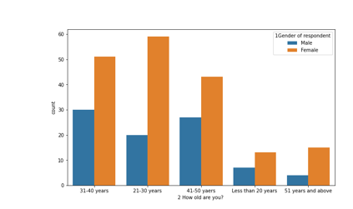
Countplots for categorical columns

Slide 7
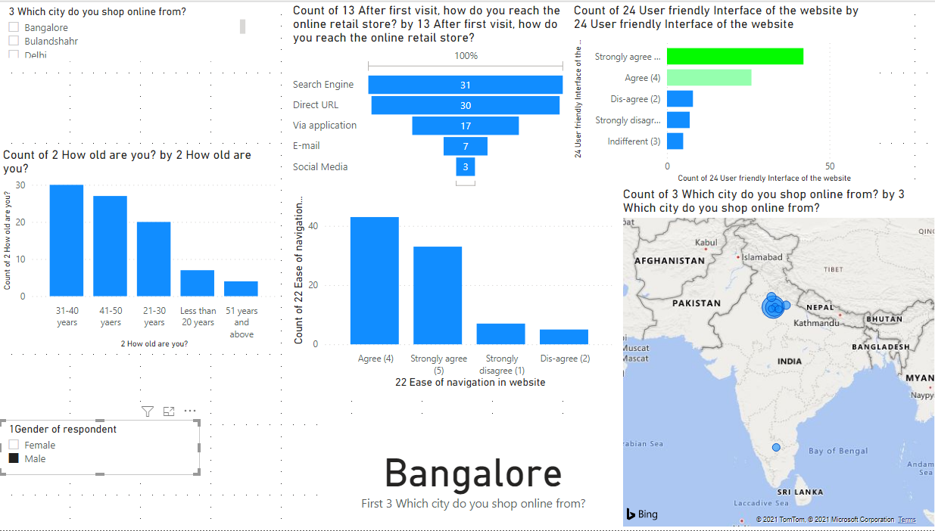
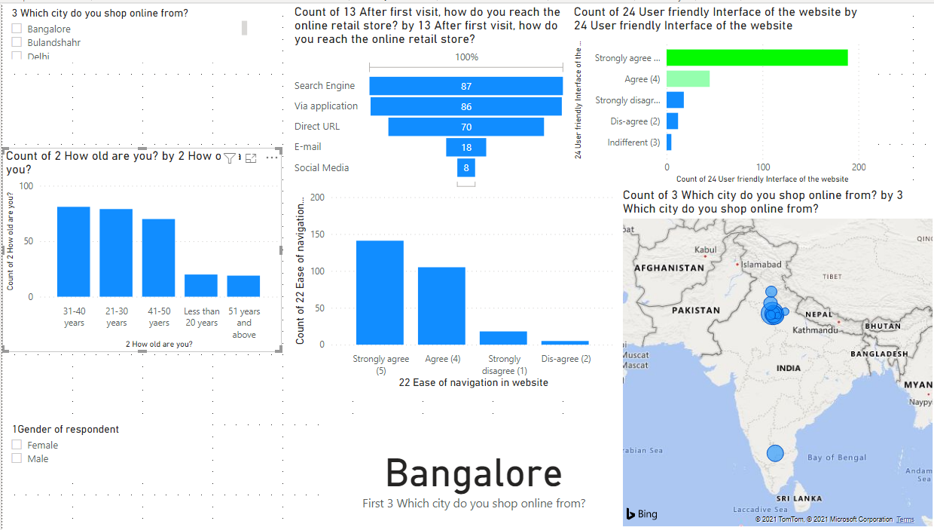
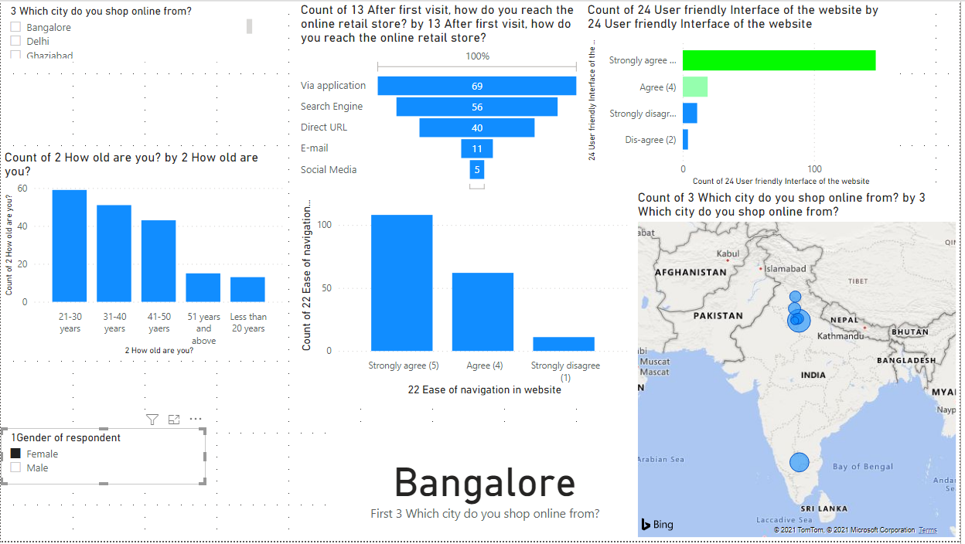
DASHBOARD
Sorted for male population
Sorted for Bangalore population
Sorted for female population

Slide 8
Conclusions
Behaviour of females shopping online:
Females tend to relate factors like trust, empathy more with e commerce.
There was a factor of enjoyment observed in females
The quality of content affects more to the female side than male side.
Females do not agree that shopping online helps fulfil certain roles.
Females believe that monetary or other benefits lead to customer satisfaction

Slide 9
Conclusions
Behaviour of males shopping online:
Male opinion was neutral when asked about same factor of enjoyment.
Quality of content does not affect much.
Males agree with the fact that they feel gratification when they shop from their favourite retailer.
Benefits like promotion cards etc are not much effective on the male audience.

